Slide 1

Mapreduce programming model
Spring 2026
Dr Mayada Hadhoud

Slide 2
outline
Parallel Programming Model
Types of Parallel Programming Models
Task Parallelism Vs. Data Parallelism
Map Reduce Programming Model Definition & Motivation
Map Reduce Basic Idea
Map Reduce Functions
Map Reduce Examples
Map Reduce is not suitable for what??

Slide 3
Parallel Programming model
A parallel programming model is:
A programming model designed to execute multiple computations simultaneously by dividing work across multiple processors or machines.
It defines:
How tasks are split
How processors communicate
How synchronization occurs
How data is shared or distributed
Notes:
An abstraction that specifies how parallel tasks are created, coordinated, and executed.
Frameworks that specify how parallel processes interact, communicate, and synchronize.
A parallel programming model provides the conceptual framework for dividing large-scale data processing tasks into smaller concurrent operations that run across distributed nodes or parallel processors, while handling coordination, communication, and synchronization.

Slide 4
Parallel Programming model types
Shared Memory Model
Multiple threads/processors access a common global memory space. Synchronization mechanisms (locks, semaphores, barriers) are required to ensure data consistency.
Examples:
OpenMP
POSIX Threads (Pthreads)

Slide 5
Parallel Programming model types
Message Passing Model
Each processor has private local memory. Communication occurs explicitly through message exchange (send/receive).
No shared memory
Characteristics
- High scalability - Works across machines - Complex to program - Programmer manages communication
Examples:
MPI
Notes:
Each process:
Has its own local memory
Communicates by explicitly sending/receiving messages
There is no shared memory.
Process A → sends data → Process B Process B → sends result → Process A
Communication is controlled by the programmer.
🔹 Characteristics
- High scalability - Works across machines - Complex to program - Programmer manages communication

Slide 6
Parallel Programming model types
Data Parallel Model
The same operation is applied concurrently to different partitions of a dataset. Focus is on data decomposition rather than task decomposition.
Examples:
Map-Reduce Model
Notes:
Same operation applied to multiple data elements simultaneously.
The data is partitioned automatically.
Instead of writing:
“Send data to process 2”
You write:
“Apply this function to all elements”
The system handles: (not the programmer)
Data splitting
Synchronization
Communication
Characteristics
- Easier to program - Good for large datasets - Implicit communication - High-level abstraction
---------------------------------------------------------------------------------------------------
Message Passing Model:
Focus = How processors communicate
You manage:
Sending
Receiving
Synchronization
Data Parallel Model:
Focus = How data is divided
You specify:
Operation
Data
System manages:
Communication
Synchronization

Slide 7
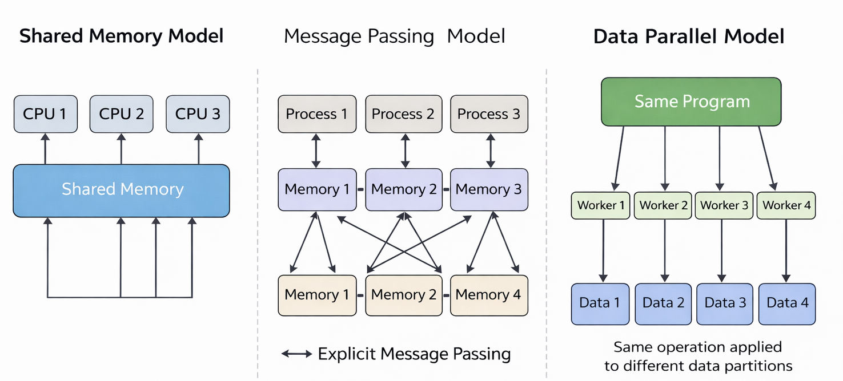

Slide 8
Task parallelism vs data parallelism
Data parallelism is a parallel computing model where the same operation is performed simultaneously on different partitions of a large dataset.
All processors execute the same code, but on different data chunks.
How It Works
Split data into partitions
Apply identical function to each partition
Combine results
Notes:
A key scientific requirement for data parallelism is that the operations on each partition should ideally be independent (stateless). If Partition A needs a result from Partition B during the operation, it becomes a "Task Parallel" or "Message Passing" problem
Data Paralelism is known also SIMD (Single instruction Multiple Data), SPMD (Single Program Multiple Data)

Slide 9
Task parallelism vs data parallelism
Task parallelism is a parallel computing model where different tasks or functions are executed simultaneously.
Each processor may execute different code.
How It Works
Divide program into independent tasks
Assign each task to a processor/thread
Tasks may operate on same or different data

Slide 10
Task parallelism vs data parallelism
Aspect | Data Parallelism | Task Parallelism
Code executed | Same | Different
Data | Different partitions | Same or different
Best for | Large datasets | Complex workflows
Used in | Hadoop, Spark | Spark, Threads, microservices
Scalability | Very high for Big Data | Depends on task independence
Notes:
Data Parallelism
“Everyone does the same job, but on different pieces of data.”
Task Parallelism
“Everyone does a different job at the same time.”
In modern big data systems, we rarely use just one. For example, a Spark job is Task Parallel because it manages a complex graph of different stages, but each of those stages is Data Parallel because it processes millions of rows at once.

Slide 11
Data locality
Data locality means moving computation to where the data is stored, instead of moving large amounts of data across the network.
Why it matters: Moving computation is cheaper than moving large datasets over the network.
Network is often the slowest resource in a cluster
Reading data locally can be 10× faster than remote reads
How it works: Job schedulers try to place tasks on DataNodes holding the required data blocks.
Benefits: Faster job execution, reduced network traffic, and better cluster utilization.
Data locality is a core optimization in Big Data systems that brings computation to the data to achieve high performance at scale.
Notes:
How Data Locality Works
Files are split into HDFS blocks
Each block is stored on multiple DataNodes (replicas)
The scheduler checks:
Where the block replicas are
Tasks are scheduled:
Node-local (same DataNode) → best
Rack-local (same rack) → acceptable
Remote (different rack) → worst
This minimizes:
Network I/O
Job execution time
Cluster congestion
Why Data Locality Matters
Network is often the slowest resource in a cluster
Reading data locally can be 10× faster than remote reads
Improves:
Performance
Scalability
Cost efficiency

Slide 12
Map reduce programming model
Map-Reduce is a data parallel programming model and an associated implementation designed for processing large data sets. It allows users to express computations as a Map function and a Reduce function.
The model aims to provide a simple abstraction that hides the "messy details" of parallelization, fault tolerance, data distribution, and load balancing in a library. This allows programmers without experience in parallel systems to easily utilize large-scale distributed resources
Developed by Google in 2008
Notes:
What is MapReduce?
• Programming model + implementation
• Developed by Google in 2008
The model was created as a reaction to the complexity of distributed computing. It aims to provide a simple abstraction that hides the "messy details" of parallelization, fault tolerance, data distribution, and load balancing in a library. This allows programmers without experience in parallel systems to easily utilize large-scale distributed resources
The run-time system takes care of the details of partitioning the input data, scheduling the program's execution across a set of machines, handling machine failures, and managing the required inter-machine communication

Slide 13
Map reduce basic idea
The core idea is to move the burden of managing distributed systems from the developer to the library.
The basic idea is: Express computation as two functions (Map and Reduce), and let the framework handle everything else.
Programmer Responsibility | Framework Responsibility
Map logic | Parallel execution
Reduce logic | Data partitioning
Combiner (optional) | Shuffle & sort
— | Fault tolerance
— | Worker coordination
Notes:
While map tasks benefit from data locality with HDFS blocks, reduce tasks must pull data from all map tasks across the cluster. This is why the shuffle phase (moving data from mappers to reducers) is often the most performance-critical part of a MapReduce job!
What the Programmer Implements:
Map function: Processes a key/value pair to generate intermediate key/value pairs.
Reduce function: Merges all intermediate values associated with the same intermediate key.
MapReduce Specification: Code to fill in input/output file names and optional tuning parameters.
What the Framework Implements:
Automatic Parallelization: Distributes computations across a large cluster of commodity machines.
Data Partitioning: Automatically splits input data into M pieces.
Scheduling: Manages the execution of tasks across various machines.
Fault Tolerance: Handles machine failures by re-executing tasks.
Communication: Manages inter-machine communication and data shuffling.
- Map Tasks: Always read data locally from HDFS blocks
- Shuffle Phase: Creates a "network crossbar" - every mapper connects to every reducer
- Reduce Tasks: Must fetch from all nodes, creating network traffic proportional to (mappers × reducers)
Data Flow:
Input: HDFS → Local read → Map → Network shuffle → Reduce → HDFS write
This is why MapReduce optimization often focuses on:
Reducing shuffle data (combiners)
Minimizing network transfers (data compression)
Balancing reducer workloads (good partitioning)

Slide 14
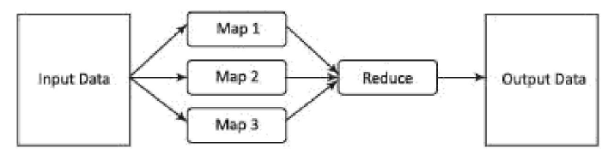
Mapreduce framework
MapReduce follows the Divide & Conquer principle, large dataset is split into smaller chunks. Chunks are processed in parallel across cluster nodes
Processing occurs in two main phases:
Map (key1​,value1​)→list(key2​,value2​)
Transforms raw input records
Produces intermediate key–value pairs
Reduce (key2​,list(value2​))→list(value3​)
Receives grouped values per key
Aggregates or summarizes them
Produces final output

Slide 15
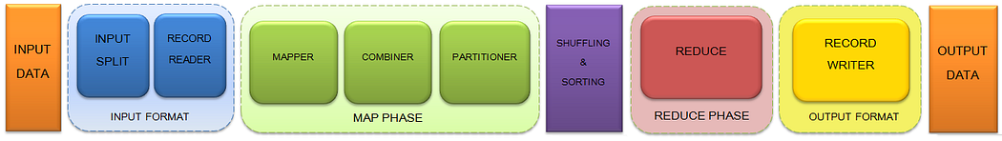
Detailed architecture and workflow
Input Files: The data for a Map Reduce task is stored in input files and these input files are generally stored in HDFS.
Notes:
Image source: https://medium.com/@maini_rohit/hadoop-map-reduce-execution-pipeline-a9eec8c5356c

Slide 16
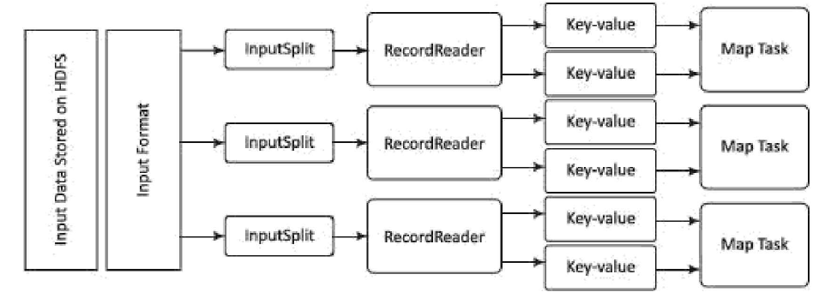
How Key–Value Pairs Are Generated for Map Tasks
1- InputSplit
Logical division of input data
Defines which portion of data each map task processes
Does NOT physically split the file
One InputSplit → One map task
2- RecordReader
Works with the InputSplit
Converts raw data into key–value records
Feeds them to the Mapper
Typically:
Key = Byte offset, Value = Line content
Notes:
InputSplit divides work. RecordReader creates key–value pairs. Shuffle groups identical keys. Reduce aggregates results.
Example file:
Hello Hadoop Big Data is powerful MapReduce is simple
Generated pairs:
(0, "Hello Hadoop") (13, "Big Data is powerful") (35, "MapReduce is simple")
The key is:
The starting byte position of the line in the file.
🔥 Why Byte Offset?
It uniquely identifies the record
It enables fault recovery
It allows re-processing from exact location
HDFS File
↓
InputSplit 1
InputSplit 2
InputSplit 3
↓
Each InputSplit assigned to a RecordReader
↓
RecordReader converts raw text
↓
Generates (key, value)
↓
Sent to Map task
------------------------------------------------------------------
MapReduce does NOT operate on files. It operates on:
A stream of (key, value) pairs.
------------------------------------------------------------------
InputSplit
Logical data chunk
Determines number of mappers
Usually matches block size
Enables parallelism
RecordReader
Converts raw data to key-value pairs
Default: (byte offset, line)
Feeds Mapper
TextInputFormat
It is the default InputFormat of MapReduce. TextInputFormat treats each line of each input file as a separate record and performs no parsing. This is useful for unformatted data or line-based records like log files.
Key – It is the byte offset of the beginning of the line within the file (not whole file just one split), so it will be unique if combined with the file name.
Value – It is the contents of the line, excluding line terminators.

Slide 17
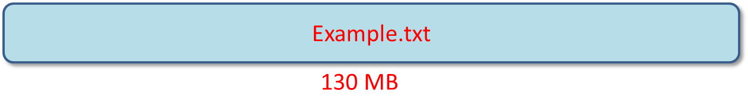
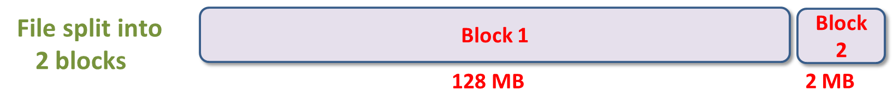
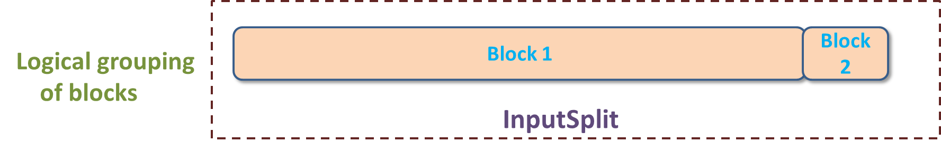
inputSplit vs block
Notes:
Images source: https://data-flair.training/blogs/mapreduce-inputsplit-vs-block-hadoop/
InputSplit is only a logical chunk of data i.e. it has just the information about blocks address or location.
During MapReduce execution, Hadoop scans through the blocks and create InputSplits and each inputSplit will be assigned to individual mappers for processing. Hence, Split act as a broker between block and mapper.

Slide 18
Map phase - mapper
Map: A user-defined function that takes an input key/value pair and produces a set of intermediate key/value pairs.
Input: input key‐value pair = input record
Output: list of intermediate key‐value pairs
Keys do not have to be unique
Duplicate pairs are permitted
Notes:
M (number of map tasks) and R (number of reduce tasks) should be much larger than the number of worker machines. Having each worker perform many different tasks improves dynamic load balancing, and also speeds up recovery when a worker fails: the many map tasks it has completed can be spread out across all the other worker machines.
Map Phase
The input dataset is divided into splits, each processed by a Map Task on the node storing the data (ensuring data locality). A RecordReader converts raw input into (key, value) pairs, which the Mapper transforms into intermediate results (e.g., "Hello Hadoop" → (Hello, 1), (Hadoop, 1)). The Map Phase generates but does not aggregate data.
Reduce Phase
Finally, reducers take the grouped keys and their associated values from the Shuffle & Sort stage. The reduce() function aggregates or summarizes them to produce the final output. For example, (Hadoop, [1,1,1]) becomes (Hadoop, 3). The consolidated results are written back into HDFS at the client-specified output location.

Slide 19
Map phase - Combiner
Combiner (Mini-Reducer - Optional): A function that performs "partial merging" of intermediate data on the map machine before it is sent over the network. It is used when there is significant repetition in intermediate keys and the Reduce function is commutative and associative. It helps save network bandwidth.
Why Combiner?
To reduce network traffic during shuffle.
· Combiner must use the same logic as reduce
· It runs locally on mapper output
· It is an optimization, not required for correctness
Combiners work only when the reduce function is associative and commutative.
Examples that work:
Sum, Count, Min, Max
Examples that don’t safely work:
Average (unless carefully rewritten), Median, Order-dependent operations
Notes:
The Combiner function is executed on each machine that performs a map task. Typically the same code is used to implement both the combiner and the reduce functions. The only difference between a reduce function and a combiner function is how the MapReduce library handles the output of the function.
The output of a reduce function is written to the nal output le. The output of a combiner function is written to an intermediate le that will be sent to a reduce task. Partial combining signicantly speeds up certain classes of MapReduce operations.
Combiners exist mainly to reduce shuffle cost, but with an important clarification.
They reduce shuffle data size, which in turn reduces:
Network transfer
Disk I/O
Sorting overhead
So indirectly, they reduce shuffle time.
Combiners work only when the reduce function is associative and commutative.
Examples that work:
Sum, Count, Min, Max
Examples that don’t safely work:
Average (unless carefully rewritten), Median, Order-dependent operations

Slide 20
Map phase - Partitioner
After the Map phase, the Partitioner determines: Which reducer will receive each key.
Default behavior (Hash partitioner):
hash(key) % number_of_reducers
Partitioner is used if we are working on more than one reducer to ensure load balancing between reducers.
Data Skew Problem
If one key appears very frequently:
→ One reducer becomes overloaded → Job becomes slow
Custom partitioning strategies help mitigate skew.
Notes:
• Same keys → same reducer • Different keys → possibly different reducers
Shuffle groups by key, but partitioner decides where that group goes.
Why Partitioner Matters
Affects load balancing
Impacts performance

Slide 21
partitioning strategies
Strategy | Idea | Complexity | Use Case
Key Salting | Split heavy keys | Low | WordCount skew
Range Partition | Partition by key range | Medium | Ordered data
Frequency-Aware | Assign heavy keys manually | High | Production systems

Slide 22
Shuffling & sorting
Shuffle Phase (Data Transfer & Grouping)
Transfers intermediate (key, value) pairs from Mappers → Reducers
Groups records by key
Ensure that all values of the same key go to the same reducer
It is the physical movement of the data which is done over the network.
Important characteristics:
Starts before all mappers finish (overlapping execution improves performance)
Involves network communication
Often the most expensive phase (network + disk operations)
Notes:
During shuffle:
Every mapper sends intermediate data across the network
Data must reach the correct reducer node
This creates many-to-many communication
In large clusters:
Hundreds of mappers
Dozens of reducers
Gigabytes or terabytes transferred
👉 Network bandwidth is much slower than RAM and CPU 👉 Network becomes the bottleneck
---------------------------------------------------------------------
Shuffle involves multiple disk operations:
Mapper writes intermediate output to local disk
Data is read from disk for transfer
Reducer writes received data to disk
Data is read again for sorting/merging
⚠ Disk I/O is slow compared to memory operations.
So shuffle is not just network-heavy, it is also disk-heavy.
In many real workloads:
Shuffle can take 50–80% of total job time
“Map is computation. Reduce is aggregation. Shuffle is distributed data movement — and movement is expensive.”
it starts before all mappers finish. This is a form of Task Pipelining. As soon as a Mapper "spills" its first sorted segment to disk, a Reducer can begin copying that segment, even if the Mapper is still processing the rest of its split.

Slide 23
Shuffling & sorting
Sort Phase (Automatic Key Ordering)
Sorts intermediate keys before they reach the reducer, Combines multiple sorted lists from Mappers into a single globally sorted stream for each Reducer
Ensures reducer receives data in sorted key order
Groups identical keys together: Consolidates all values for a unique key into a single list: K→[V_1, V_2, V_3, ...].
Why important?
Enables efficient aggregation
Because the data is sorted, the Reducer doesn't have to search the whole dataset to find all certain key. They are all right next to each other in the stream.
Ensures deterministic processing
Makes reducers simpler (reducer logic complexity reduction)
Notes:
The shuffle and sort phases are the hidden engine that makes distributed aggregation possible.
Without shuffle → reducers would not receive grouped data. Without sort → reducers could not process grouped keys efficiently.
Sorting puts keys in order (A, A, B, C, C, C).
Grouping ensures that the Reducer receives a single call for Key A with an iterator containing all its values.
The Sort actually begins on the Mapper node (in-memory buffer) to save time .
The Merge (final sorting) happens on the Reducer node after it fetches the data.

Slide 24
reduce phase
Reduce: A user-defined function that accepts an intermediate key and a set of values for that key. It merges these values to form a possibly smaller set of values.
Input: intermediate key + list of (all) values for this key
Output: possibly smaller list of values for this key
Reducers run in parallel as they are independent of one another. The user decides the number of reducers. By default, the number of reducers is 1.
Notes:
M (number of map tasks) and R (number of reduce tasks) should be much larger than the number of worker machines. Having each worker perform many different tasks improves dynamic load balancing, and also speeds up recovery when a worker fails: the many map tasks it has completed can be spread out across all the other worker machines.
Map Phase
The input dataset is divided into splits, each processed by a Map Task on the node storing the data (ensuring data locality). A RecordReader converts raw input into (key, value) pairs, which the Mapper transforms into intermediate results (e.g., "Hello Hadoop" → (Hello, 1), (Hadoop, 1)). The Map Phase generates but does not aggregate data.
Reduce Phase
Finally, reducers take the grouped keys and their associated values from the Shuffle & Sort stage. The reduce() function aggregates or summarizes them to produce the final output. For example, (Hadoop, [1,1,1]) becomes (Hadoop, 3). The consolidated results are written back into HDFS at the client-specified output location.

Slide 25
Record writer
It writes the output key-value pair from the Reducer phase to the output files.
The final output of reducer is written on HDFS by Output Format. Output Files are stored in a File System.
Notes:
The way these output key-value pairs are written in output files by RecordWriter is determined by the Output Format. The Output Format and InputFormat functions are alike. OutputFormat instances provided by Hadoop are used to write to files on the HDFS or local disk. OutputFormat describes the output-specification for a Map-Reduce job.
TextOutputFormat (most common output format)
MapReduce default Hadoop reducer Output Format is TextOutputFormat, which writes (key, value) pairs on individual lines of text files and its keys and values can be of any type since TextOutputFormat turns them to string by calling toString() on them. Each key-value pair is separated by a tab character,

Slide 26
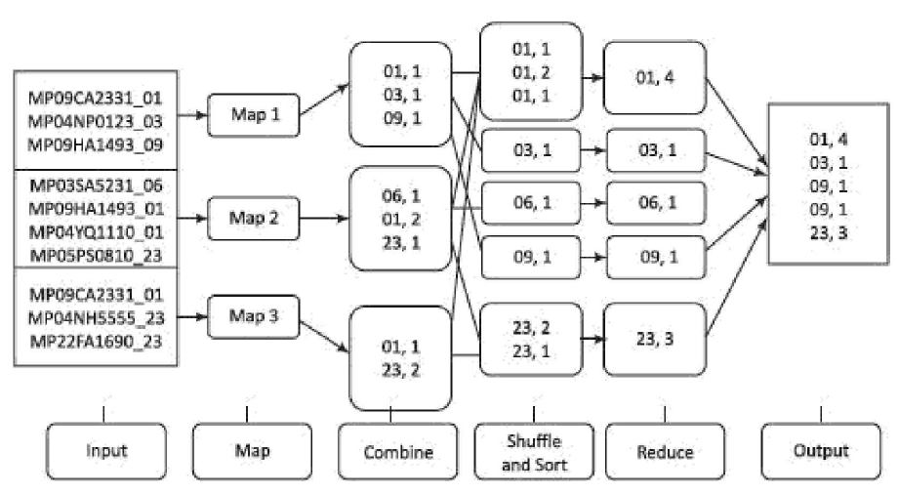
Notes:
Disk IO operation
Stage Location Action
Emit RAM (Buffer) Data is partitioned.
Spill Local Disk Data is sorted and written to a temporary file.
Merge Local Disk All spills are combined into one indexed file.
Shuffle Network Reducers "pull" their specific partitions over HTTP.

Slide 27
Mapreduce job execution workflow
1. Job Submission (Client Layer)
Client submits a MapReduce job to the cluster
Job includes:
Mapper class
Reducer class
Input path (HDFS)
Output path (HDFS)
Job configuration parameters
2. Job Coordination (Master Layer)
JobTracker (MRv1) receives the job
Splits job into:
Multiple Map Tasks
Multiple Reduce Tasks
Schedules tasks on TaskTrackers
Uses data locality to assign Map tasks near the data blocks
JobTracker resides in the master node, while TaskTrackers reside in the DataNodes

Slide 28
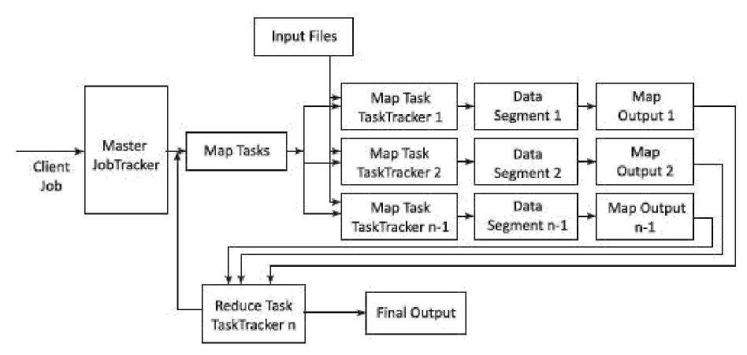
Mapreduce process
Notes:
Job trackers:
1 Master job tracker in the master node
And one slave job tracker per worker node
The JobTracker was the master component in Hadoop MapReduce responsible for coordinating and managing job execution across the cluster. It scheduled map and reduce tasks to available TaskTrackers, monitored task progress and overall job status, managed cluster resources and job queues, and ensured fault tolerance by detecting node failures and reassigning unfinished tasks to maintain successful job completion.
The TaskTracker was the worker component in Hadoop MapReduce responsible for executing assigned map and reduce tasks on each cluster node. It ran tasks as instructed by the JobTracker, reported progress through regular heartbeats, managed local task slots and resources, handled task failures by retrying when possible, and performed cleanup after job completion.

Slide 29
Mapreduce job execution workflow
3. Map Phase (Parallel Processing)
TaskTrackers execute Map tasks on local InputSplits
Each Map task:
Reads input data
Processes records
Produces intermediate (key, value) pairs
4. Shuffle & Sort Phase (Data Redistribution)
Intermediate data is:
Partitioned by key
Transferred across the network
Grouped by identical keys
Sorted before being sent to reducers

Slide 30
Mapreduce job execution workflow
5. Reduce Phase (Aggregation)
Reduce tasks receive grouped keys with list of values
Apply aggregation or processing logic
Generate final output records
6. Output Storage
Final results are written back to HDFS
Each Reduce task produces one output file

Slide 31
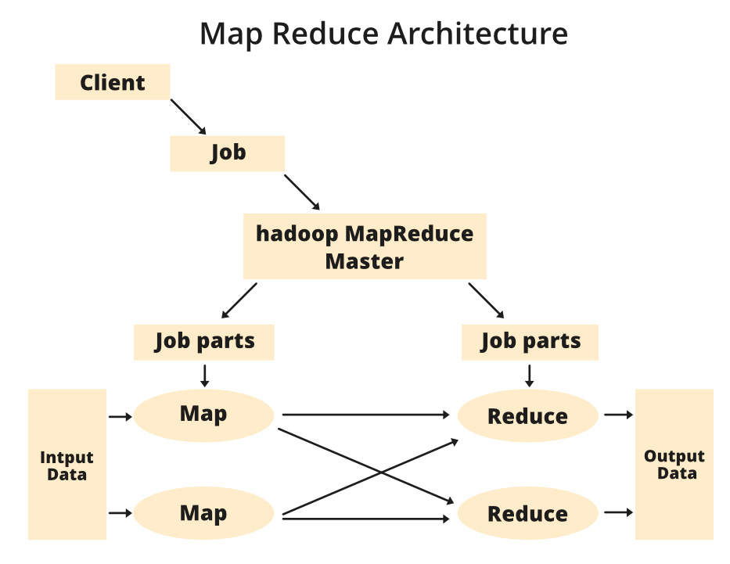
Notes:
Source: https://www.geeksforgeeks.org/software-engineering/mapreduce-architecture/
How does a distributed system execute a job in parallel across a cluster?
This diagram shows the control flow and data flow of a MapReduce job.
Client → Job Submission
🔹 Client
The user (or application)
Submits a MapReduce job
Specifies:
Input path
Output path
Mapper class
Reducer class
Number of reducers
The client does NOT process data. It only submits the job.
3️⃣ Job Parts → Map Phase
The master divides the job into:
Job → Multiple Map Tasks
Each Map task:
Processes one InputSplit
Runs on a cluster node
Produces intermediate key-value pairs
5️⃣ Reduce Phase
Reducers:
Receive grouped keys
Process all values of a key together
Produce final results
Client
↓
Submit Job
↓
Master splits job
↓
Multiple Map tasks (parallel)
↓
Shuffle & Sort
↓
Multiple Reduce tasks (parallel)
↓
Final Output in HDFS
Important Concepts to Emphasize
🔹 Parallelism
Maps run in parallel
Reduces run in parallel
Scales horizontally
🔹 Data Locality
Map tasks try to run:
On the same machine where the data block resides
Minimizes network cost.
🔹 Fault Tolerance
If:
A mapper fails → re-executed
A reducer fails → re-executed
Because data is stored in HDFS.
Execution Flow of MapReduce Architecture
Client submits the job includes JAR file, Mapper & Reducer logic, input path and output path.
Job Tracker accepts the job, splits it into tasks and assigns them to Task Trackers based on data locality.
Task Trackers execute Map Tasks on input splits stored locally.
Intermediate results are shuffled and sorted.
Reduce Tasks process grouped results and generate the final output.
Final output is written back to HDFS.
Hadoop MapReduce Master
The Master Node coordinates job execution. It:
Accepts jobs from the Client.
Splits them into job parts.
Assigns these parts to the Map and Reduce tasks.
Tracks execution progress and reassigns failed tasks.

Slide 32
Example 1: word count
Count word frequencies in a large distributed file.
Example:
Big data is transforming the world
Big data technologies are powerful
Data science uses big data
The world of data is growing
Big systems process big data

Slide 33
Example 1: word count
Big data is transforming the world
Big data technologies are powerful
Data science uses big data
The world of data is growing
Big systems process big data
Step 1: Input Splitting
Split 1
Big data is transforming the world
Big data technologies are powerful
Split 2
Data science uses big data
Split 3
The world of data is growing
Big systems process big data
Each split → 1 Mapper
Notes:
Splitting: The parameter of splitter can be anything. By comma, space, by a new line or a semicolon.

Slide 34
Example 1: word count
Step 2: Map Phase
Split 1
(big,1)
(data,1)
(is,1)
(transforming,1)
(the,1)
(world,1)
(big,1)
(data,1)
(technologies,1)
(are,1)
(powerful,1)
Split 3
(the,1)
(world,1)
(of,1)
(data,1)
(is,1)
(growing,1)
(big,1)
(systems,1)
(process,1)
(big,1)
(data,1)
def map_function(line):
words = line.split()
for word in words:
emit(word.lower(), 1)
Split 2
(data,1)
(science,1)
(uses,1)
(big,1)
(data,1)
Notes:
The map_function(line) signature means:
Input: ONE line of text
Called: Once for EVERY line in the input split
Total calls: Number of lines in your entire dataset
Output: Emits key-value pairs for that single line
The map function is designed this way to be scalable, memory-efficient, and parallelizable - it doesn't need to know about splits or HDFS, it just processes whatever line the framework gives it, one at a time!
Regardless of the language you use, every "emit" statement must follow these rules to be valid in a MapReduce framework:
1- The Key-Value Contract: You cannot just emit a single value. You must emit a Pair (even if the Key is "null"). The framework needs that Key to know where to send the data during the Shuffle phase.
2- The "Tab" Convention (Streaming): If you are using stdin/stdout (Python/C++), you must separate the Key and Value with a Tab character (\t). If you use a space or a comma, Hadoop might think the entire line is just a Key with an empty Value.
"Concept: Emit (K, V)"
"Implementation:"
Java: context.write(K, V)
Python: print(K + "\t" + V + "\n")
Result: The data is handed off to the Shuffle/Sort engine.
stdin (Standard Input) and stdout (Standard Output) are the "data pipes" that every program uses to talk to the outside world.
stdin and stdout act as the communication "pipes" between the Java-based Hadoop framework and your external script (like Python or C++). The framework reads data from an HDFS split and "pushes" it into your script's stdin line-by-line; your script then processes this data and "emits" results by printing them to stdout as tab-separated Key-Value pairs. Hadoop captures everything from your script's stdout, treats the text before the first tab as the Key and the rest as the Value, and then passes that data into the Shuffle and Sort phase. Because of this "piping" mechanism, any accidental print() or debug statement in your code will be misinterpreted by Hadoop as actual data, potentially corrupting your output or causing the job to fail.

Slide 35
Example 1: word count
Step 3: Combiner Phase
Split 1
(big,2)
(data,2)
(is,1)
(transforming,1)
(the,1)
(world,1)
(technologies,1)
(are,1)
(powerful,1)
Split 3
(the,1)
(world,1)
(of,1)
(data,2)
(is,1)
(growing,1)
(big,2)
(systems,1)
(process,1)
def combiner(word, values):
return (word, sum(values))
Split 2
(data,2)
(science,1)
(uses,1)
(big,1)

Slide 36
Example 1: word count
Step 4: Shuffle & Sort Phase
Shuffle groups identical keys from all mappers:
All values for same key → same reducer.
(big, [2,1,2])
(data, [2,2,2])
(is, [1,1])
(world, [1,1])
...

Slide 37
Example 1: word count
Final Output
big → 5
data → 6
is → 2
world → 2
the → 2
technologies → 1
are → 1
powerful → 1
science → 1
uses → 1
growing → 1
systems → 1
process → 1
Step 5: Reduce Phase
def reduce_function(word, values):
emit(word, sum(values))

Slide 38
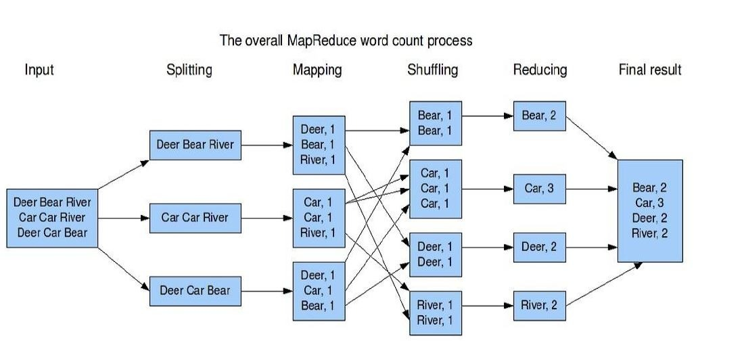
Notes:
Image source: https://i.sstatic.net/lRpoU.jpg

Slide 39
Example 2: inverted index
Given multiple documents, create an index that shows:
For each word → which documents contain it.
Example:
Expected Output
big → [Doc1, Doc2, Doc3]
data → [Doc1, Doc2, Doc3]
science → [Doc2]
systems → [Doc3]
powerful → [Doc1]
is → [Doc1]
uses → [Doc1]
process → [Doc1]
Input
Doc1: Big data is powerful
Doc2: Data science uses big data
Doc3: Big systems process data
Notes:
Inverted Index Used in:
Search engines (Google)
Document retrieval systems
Information retrieval

Slide 40
Example 2: inverted index
Doc1: Big data is powerful
Doc2: Data science uses big data
Doc3: Big systems process data
Step 1: Input Splitting
Split 1
Doc1: Big data is powerful
Split 2
Doc2: Data science uses big data
Split 3
Doc3: Big systems process data
Each Mapper receives (docID, document_text)

Slide 41
Example 2: inverted index
Step 2: Map Phase
def map_function(doc_id, text):
words = text.split()
for word in words:
emit(word.lower(), doc_id)
Split 1
(big, Doc1)
(data, Doc1)
(is, Doc1)
(powerful, Doc1)
Split 2
(data, Doc2)
(science, Doc2)
(uses, Doc2)
(big, Doc2)
(data, Doc2)
Split 3
(big, Doc3)
(systems, Doc3)
(process, Doc3)
(data, Doc3)

Slide 42
Example 2: inverted index
Step 3: Shuffle & Sort Phase
The shuffle phase:
Groups all identical words together
Sends them to the same reducer
"data" appears twice in Doc2 → duplicate entry
big → [Doc1, Doc2, Doc3]
data → [Doc1, Doc2, Doc2, Doc3]
science → [Doc2]
systems → [Doc3]
powerful → [Doc1]
Is → [Doc1]
Process → [Doc3]
Uses → [Doc2]

Slide 43
Example 2: inverted index
Final Output
big → [Doc1, Doc2, Doc3]
data → [Doc1, Doc2, Doc3]
science → [Doc2]
systems → [Doc3]
powerful → [Doc1]
is → [Doc1]
uses → [Doc2]
process → [Doc3]
Step 4: Reduce Phase
For each word:
Remove duplicate document IDs
Produce unique document list
def reduce_function(word, doc_ids):
unique_docs = set(doc_ids)
emit(word, list(unique_docs))

Slide 44
Example 3: Language model
Need to count number of times every 5-word sequence occurs in a large corpus of documents
A 5-word sequence (5-gram) is any consecutive group of 5 words
Example Sentence:
"The quick brown fox jumps over the lazy dog"
Extracted 5-word sequences:
"The quick brown fox jumps"
"quick brown fox jumps over"
"brown fox jumps over the"
"fox jumps over the lazy"
"jumps over the lazy dog“
Notes:
Example source: https://web.stanford.edu/class/cs246/slides/01-intro.pdf
This pattern is used for:
Language Models - Predicting next words in text
Plagiarism Detection - Finding copied text segments
Author Attribution - Identifying writing style patterns
Machine Translation - Building phrase tables
Search Engines - Creating search suggestions

Slide 45
Example 3: Language model
Map phase
Extract all 5-word sequences from each document
Emit (sequence, 1) for each occurrence
Shuffle & Sort Phase
Group all emitted pairs by sequence
Prepare for aggregation
Reduce Phase
Sum up the counts for each unique sequence
Output final (sequence, total_count)

Slide 46
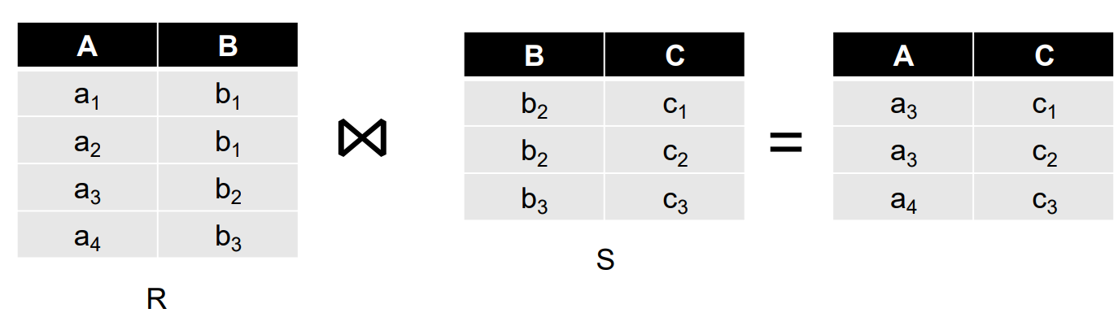
Example 4: join by sql query
Compute the natural join R(A,B) ⋈ S(B,C)
R and S are each stored in files
Tuples are pairs (a,b) or (b,c)
Map Task turns
Each input tuple R(a,b) into key-value pair (b,(a,R))
Each input tuple S(b,c) into (b,(c,S))
Reduce Task
Matches all the pairs (b,(a,R)) with all (b,(c,S)) and outputs (a,b,c).
Notes:
Example source: https://web.stanford.edu/class/cs246/slides/01-intro.pdf

Slide 47
Fault tolerance in mapreduce
Task Re-Execution
If a Map or Reduce task fails:
The master detects failure
Task is re-executed on another node
Input data remains safe in HDFS
No need to restart entire job
Speculative Execution (Straggler Handling)
If one task is unusually slow:
System launches a duplicate copy
First to finish wins
Prevents “straggler” from delaying whole job
Fault tolerance is built into the model, not handled manually by the programmer.
Notes:
🔹 2. Heartbeat Mechanism
TaskTrackers send periodic heartbeats
If heartbeat stops → node assumed failed
All unfinished tasks are reassigned
🔹 3. Deterministic Processing
Map and Reduce functions are:
Stateless
Deterministic (same input → same output)
This allows safe re-execution without inconsistencies.
🔹

Slide 48
Mapreduce performance
Heavy Disk I/O
Map output written to disk
Shuffle writes to disk
Reduce output written to disk
Expensive Shuffle Phase
Network transfer between nodes
Sorting cost
This phase often dominates execution time
High Latency Model
Notes:
🔹 Strengths of MapReduce
✔ Massive horizontal scalability ✔ Strong fault tolerance ✔ Handles very large batch workloads ✔ Excellent for simple aggregation jobs

Slide 49
mapreduce is not suitable for what?
MapReduce rigid Map → Shuffle → Reduce structure makes it highly inefficient for several categories of problems.
1. Iterative Algorithms (Machine Learning & Graph Processing)
2. Real-time or Low-Latency Processing
3. Interactive queries
4. Highly Sequential/ Dependent Tasks
If the algorithm needs many iterations or real-time responses → MapReduce is probably not the right tool.
Notes:
1. Iterative Algorithms (Machine Learning & Graph Processing)
This is the most significant limitation. Many ML algorithms (like K-Means clustering or PageRank) require multiple passes over the same data.
The Problem: MapReduce is stateless. To run a second iteration, it must write data to HDFS at the end of the first job and reload it for the second.
The Result: Immense I/O overhead. This is why Apache Spark (which keeps data in memory) replaced MapReduce for these tasks.
Better:
Apache Spark (in-memory RDD caching)
2. Real-time or Low-Latency Processing
MapReduce is a batch processing engine designed for high throughput, not high speed.
The Problem: The overhead of starting a job, allocating containers (via YARN), and the mandatory "Shuffle" phase adds minutes of latency.
The Result: It cannot be used for "streaming" data (like live credit card fraud detection or stock market ticks) where a sub-second response is required.
Better tools:
Apache Spark (Structured Streaming)
Apache Flink
Apache Kafka
Interactive Queries
Users expect results in seconds.
MapReduce:
High job startup time
Heavy disk writes
❌ Not good for:
SQL-style interactive queries
BI dashboards
Better:
Apache Hive (on Tez/Spark)
Presto
Highly Sequential / Dependent Tasks
MapReduce assumes:
Data can be split independently.
Not suitable when:
Step B depends tightly on Step A
Strong ordering constraints
Complex workflows with many dependencies

Slide 50
Start
|
├── Real-time?
| ├── Yes → Flink / Spark Streaming
| └── No
|
├── Iterative?
| ├── Yes → Spark
| └── No
|
├── Simple large-scale batch?
| ├── Yes → MapReduce
| └── No → Spark
|
└── Interactive SQL?
├── Yes → Hive / Presto

Slide 51
